Slide 1
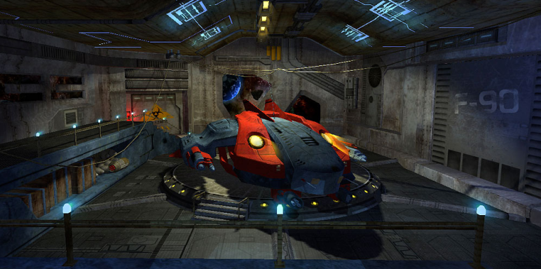
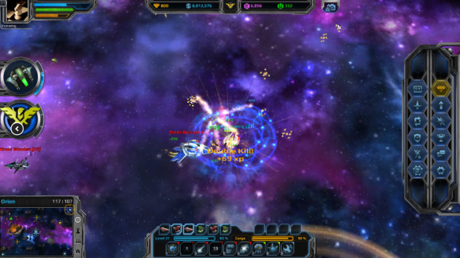

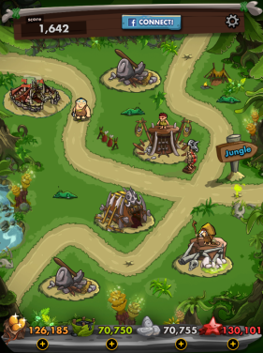

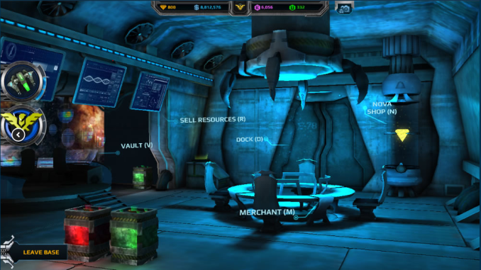


Unity 3D Course
Who are we?
Andromeda 5
Lady Popular
Dino Jack
Twist & Turn

Slide 2

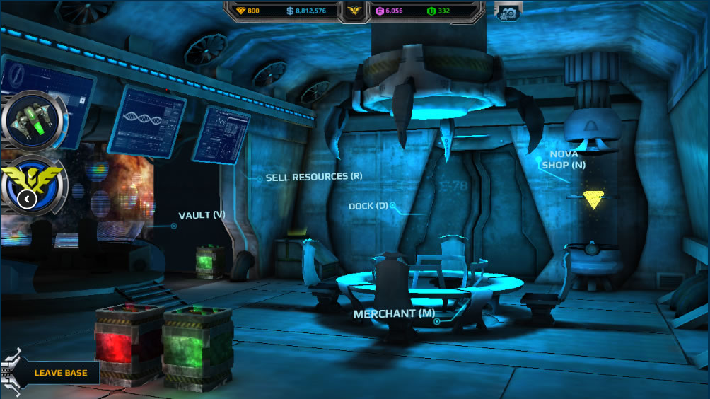

Andromeda 5
Entirely in 3D
Custom UI system based on core unity UI
Client - Server – DB architecture

Slide 3
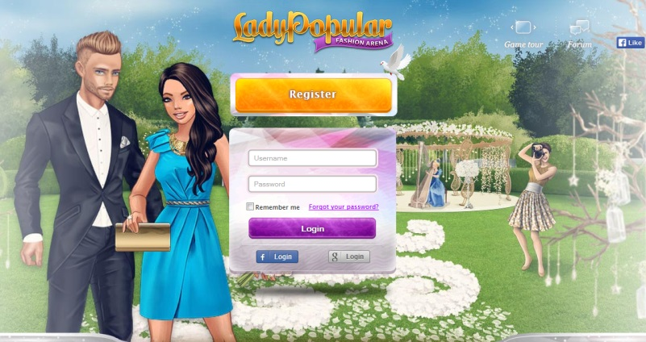
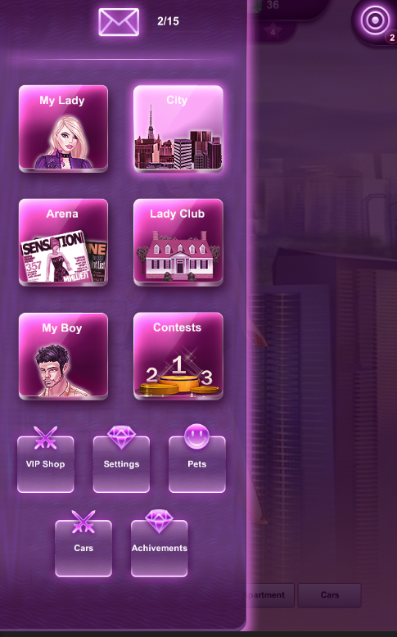
Lady Popular
External GUI System (NGUI)
Client – server

Slide 4

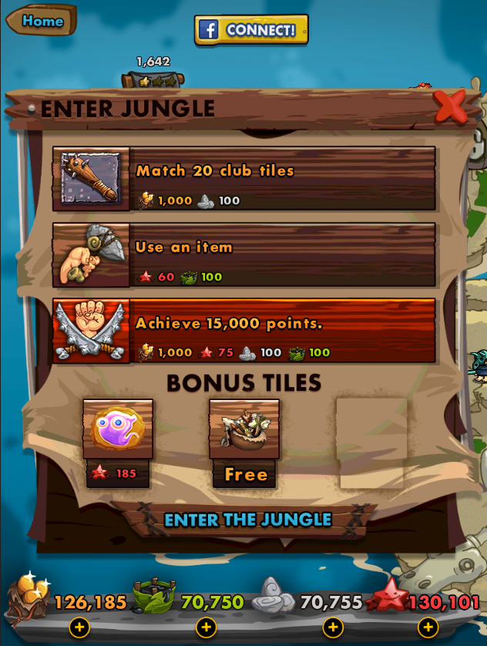
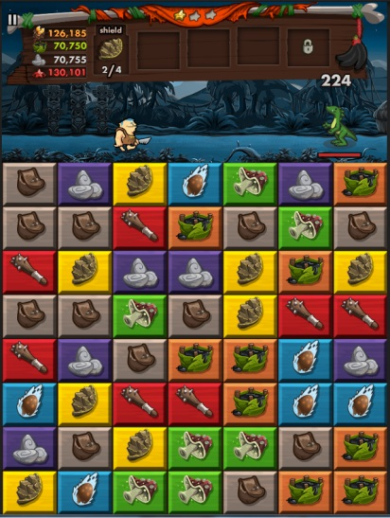
Dino Jack
2D Engine
Hybrid UI
FB plugin

Slide 5
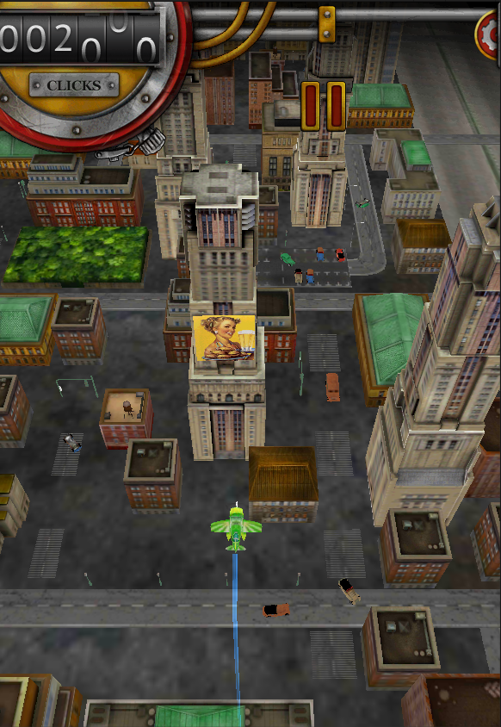
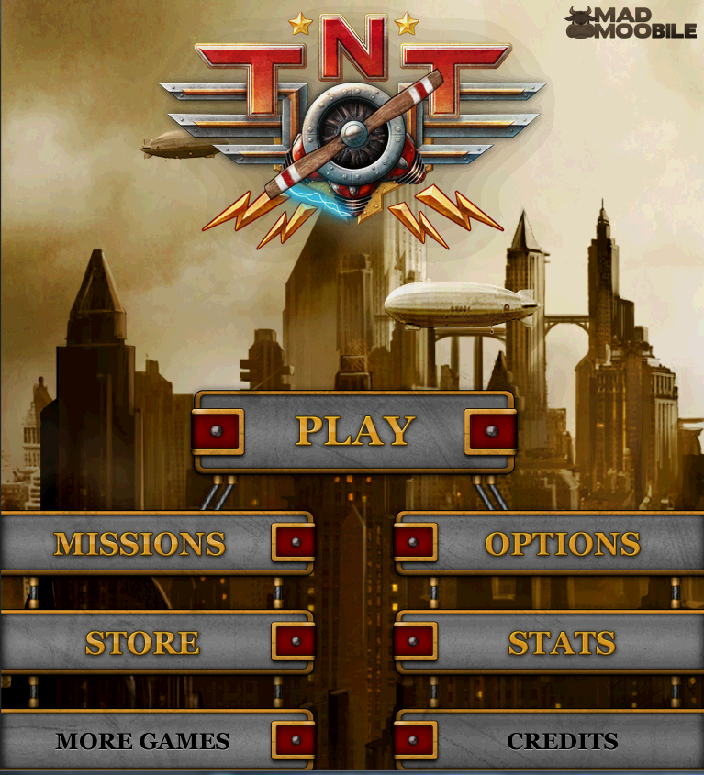
Twist & Turn
Unity Physics
Early Unity UI
Unity Input/Touch

Slide 6
Unity 3D Course
Lection 1.Unity Basics

Slide 7
What is Unity 3D ?
Lection 1.Unity Basics
Multi - Platform Game Engine
Supported Languages – C#, JS, Boo
Mono
http://unity3d.com/

Slide 8
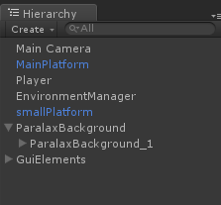
World position and coordinate system
Lection 1.Unity Basics
Cartesian coordinate system(Vector 3)
Local and world position(child/ parent)
Rotation(Euler/ Quaternion)

Slide 9
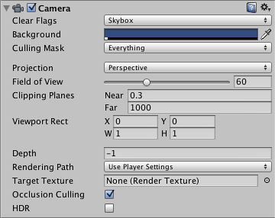
Cameras
Lection 1.Unity Basics
Define what player sees
Properties
Multiple cameras

Slide 10
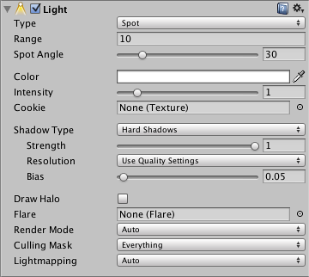
Lights & Shadows
Lection 1.Unity Basics
Lights types
Shadows types
Performance/Baking
Quality Settings

Slide 11
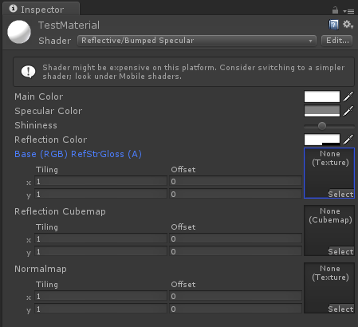
Shaders and Materials
Lection 1.Unity Basics
Shaders
Materials

Slide 12
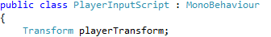
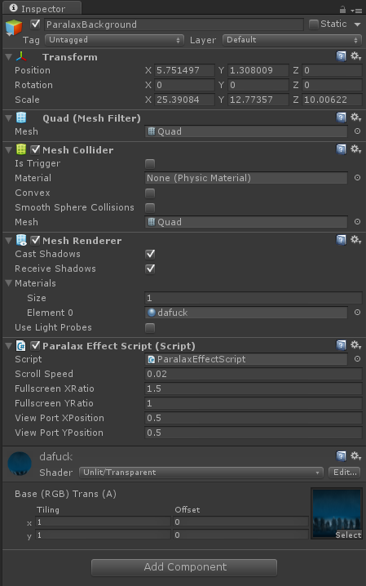
GameObjects and Components
Lection 1.Unity Basics
What is GameObject
MonoBehaviour
Components

Slide 13
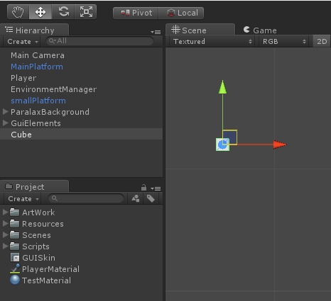
Scene, Hierarchy and Assets
Lection 1.Unity Basics
Parent/Child relation
Scene hierarchy
Assets hierarchy

Slide 14
Interface
Lection 1.Unity Basics
Scene
Game
Inspector
Hierarchy
Project
Console
Animation
Animator
Asset Store

Slide 15
MonoBehaviour Basics
Lection 1.Unity Basics
FixedUpdate , Update, LateUpdate
Awake, Start
OnEnable, OnDisable

Slide 16
MonoBehaviour Basics
Lection 1.Unity Basics
Transform
Translate, Rotate
Activate/ Deactivate GameObject
Destroy
Input.GetKey()

Slide 17
Your first game! (lab part)
Lection 1.Unity Basics

Slide 18
Useful links
Lection 1.Unity Basics
http://docs.unity3d.com/Manual/
http://docs.unity3d.com/ScriptReference/
http://unity3d.com/learn/tutorials/modules

